Slide 1

Grayscale Image Colorization
Illuminating Darkness

Slide 2

Team Members
Ahmed Hamdy
Ahmed Kamal
Ahmed Mostafa
Ahmed Nasser

Slide 3
Supervision
Dr. Dina Khattab
TA. Nora Youssef

Slide 4
Introduction
Colorization — adding colors to gray-scale images .
The underlying issue is that the resultant image needs to be perceptually meaningful, and visually appealing.

Slide 5
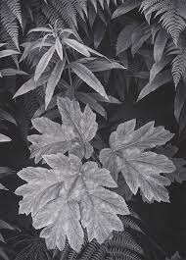
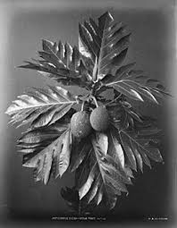
Problem Definition
Automated image colorization is an ill-posed problem, as two objects with different colors can appear the same on grayscale image .

Slide 6

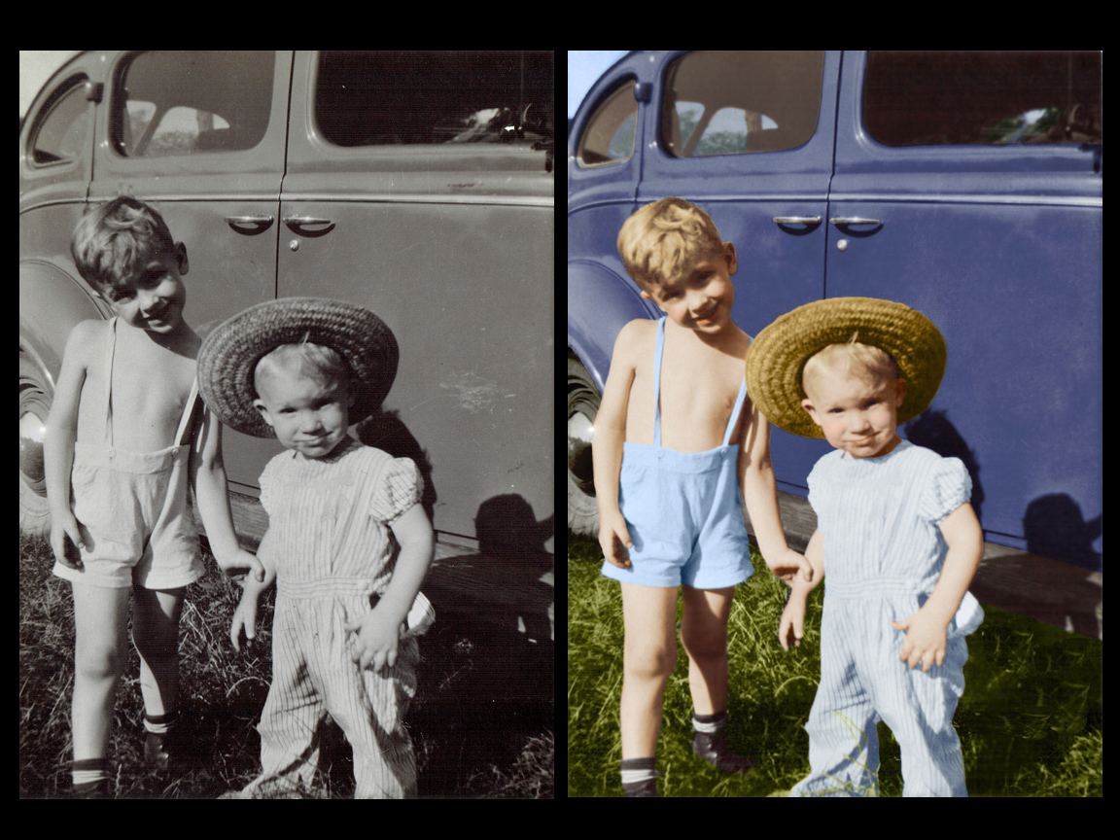
Problem in terms of input & output Input : Grayscale image.. Output : Colorized version of the grayscale image..

Slide 7
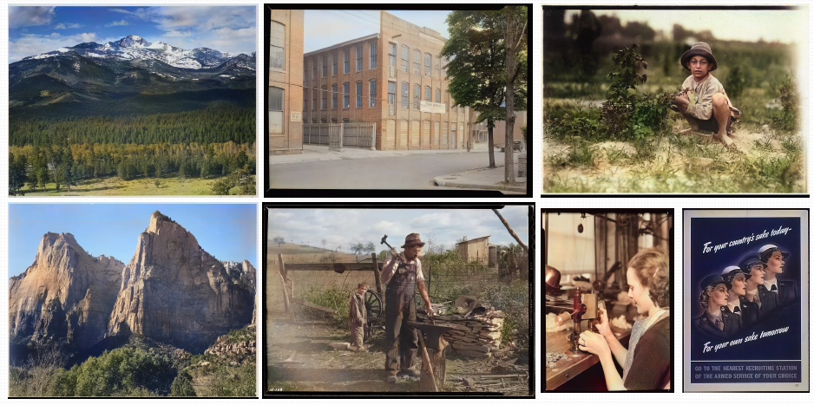
Motivation

Slide 8
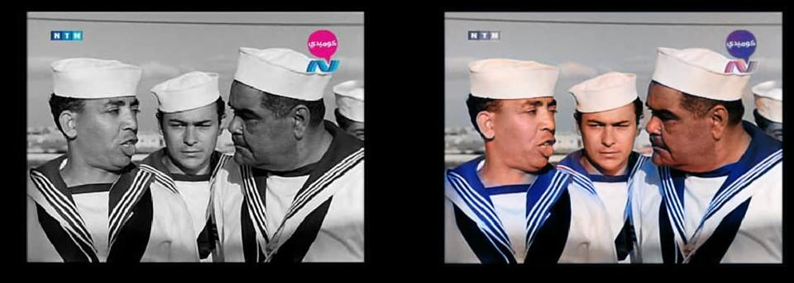
Motivation
For Cinematography..
https://www.facebook.com/ZEZO360?__tn__=%2CdCH-R-R&eid=ARCPNZfBGo4RQIleTtReL_RVdbTLjCSCGvCnfSyuKjCybAluKUDbSBFZmDqL476jPd9DpQEoWMKnS_Rm&hc_ref=ARR2DcG_79dwV52cKhc1BQrtEGlVpdZlQjUXTNQvxMFy7vb80ubG51nor7qvt_w5ZXk&fref=nf&hc_location=group

Slide 9
Project Objectives
Reviewing the state of the art in the auto colorization field.
Studying the neural networks and CNN in parallel with the project life time.
Designing and implementing the project .
Writing the project documentation in parallel with the project life time.

Slide 10

Project Goal
Develop a desktop application to colorize black & white photos.

Slide 11
Related Work
Simi-Automated Methods
Automated Methods

Slide 12

Semi-Automated Methods “methods that require some user interaction”.
Paper | Authors | Year | Technique
Transferring Color to Greyscale Images Colorization Using Optimization Automatic Image Colorization Via Multimodal Predictions | Welsh, Klaus Muller Levien et al ,Dani Lischinski Charpiat et al | 2002 2004 2008 | Using reference image Using Color “Scribbles” Using reference image

Slide 13
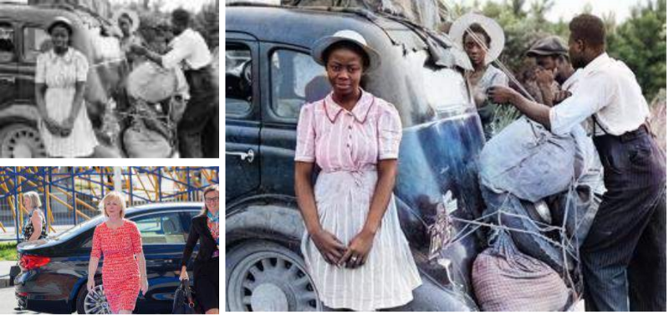
Semi-Automated Methods
Using reference image
Input
Output
Reference

Slide 14
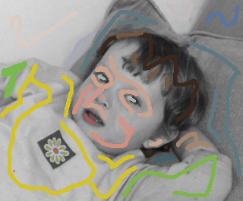
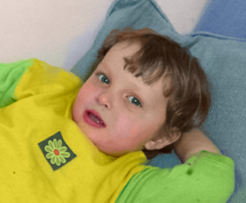
Semi-Automated Methods
Using color “Scribbles”

Slide 15
Automated Methods “methods that doesn’t require any user interaction”.
Paper | Authors | Year | Technique | Dataset
Colorful image colorization Let there be color! | Zhang , Isola and Efros Satoshi Iizuka ,Edgar Simo-Serra and Hiroshi Ishikawa | 2016 2016 | Deep Learning (CNN) Deep Learning (CNN) | ImageNet ImageNet

Slide 16
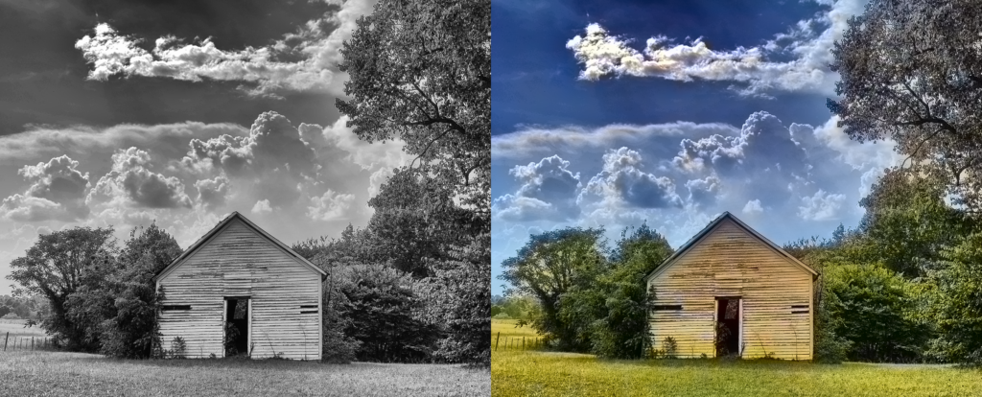
Automated Methods
Using deep learning “CNN”

Slide 17
System Phases
Input grayscale image
Pre-Processing
Automatic Features Extracting
Training
Color Labeling and Mapping
Output colorized Image

Slide 18
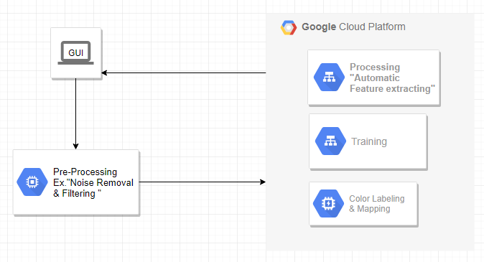
System Architecture

Slide 19
Time Plan
Survey
Start Date [Oct,2018]
End date [Dec,2018]
Auto-Feature extracting and implementation
Start Date [Jan,2019]
End Date [Mar,15th]
Constructing Network & rest of implementation
Start Date [Mar,15th]
End Date [Apr,2019]
Project testing
Documentation
Start Date [Apr,2019]
End Date [May,2019]
Start Date [Oct,2018]
End Date [May,2019]

Slide 20
Challenges
Most of image colorization algorithms commonly require user input, either in the form of color annotations or a reference image.
Working only on a single category.

Slide 21
Tools
Python
Libraries (OpenCV..)

Slide 22
References
T. Welsh, M. Ashikhmin , and K. Mueller, “Transferring color to greyscale images,” in SIGGRAPH ’02: Proc. of the 29th annual conf. on Computer graphics and interactive techniques, pp. 277–280, ACM Press, 2002.
A. Levin, D. Lischinski , and Y. Weiss, “Colorization using optimization,” in SIGGRAPH ’04, (Los Angeles, California), pp. 689–694, ACM Press, 2004.
Automatic Image Colorization Varun Ramesh and Harrison Ho CS229: Machine Learning,2015.
Guillaume Charpiat , Matthias Hofmann, and Bernhard Scholkopf. Au- ¨Automatic image colorization via multimodal predictions. In Computer Vision–ECCV 2008, pages 126–139. Springer, 2008.
Statoshi Lizuka , Edgar Serra , Hiroshi Ishikawa , “Let there be Color!: Joint End-to-end Learning of Global and Local Image Priors for Automatic Image Colorization with Simultaneous Classification”, Waseda university , 2016.
Richard Zhang, ”Colorful image Colorization” , Department of Electrical Engineering and Computer Sciences, UC Berkeley,14th European Conference in computer vision (ECCV) , Amsterdam 2016.
R.Zahng , J.Y.Zhu , P.Isola , A.A.Efros , Real Time User-Guided Image Colorization with learned deep piriors , In SIGGRAPH , 2017.

Slide 23
Any Questions ?

Slide 24
Thank You!

